Slide 1
CITI Training for IACUC
Animal Welfare Office
January 2019

Slide 2
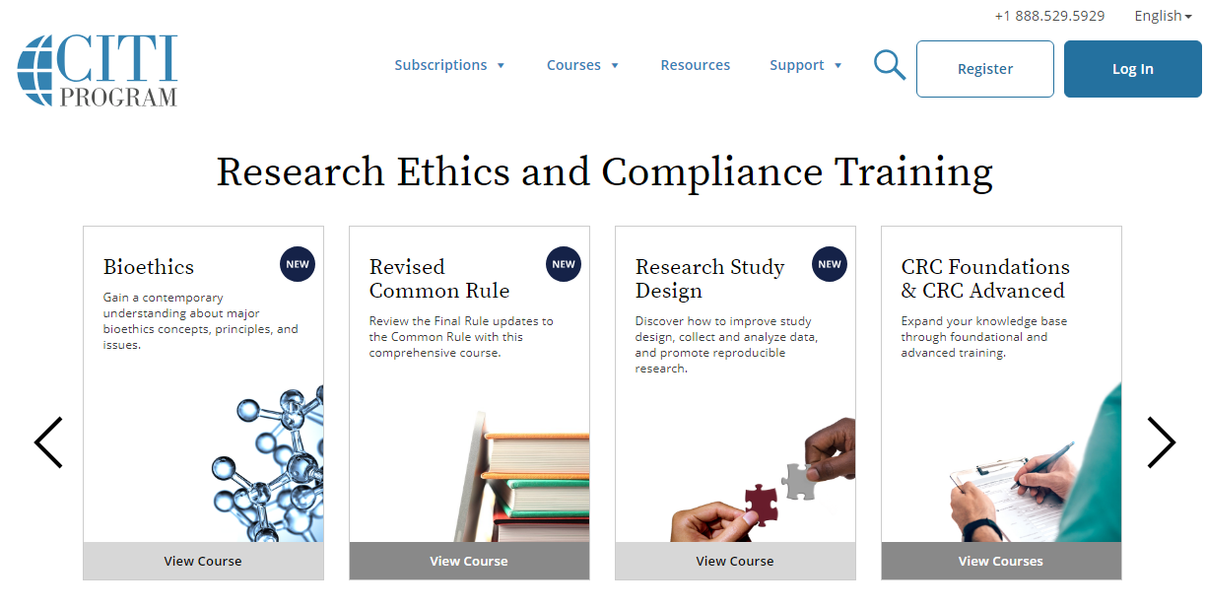
Log In
To access CITI training, go to www.citiprogram.org
Log in using an existing account
OR
New Users: Click Register to create an account

Slide 3
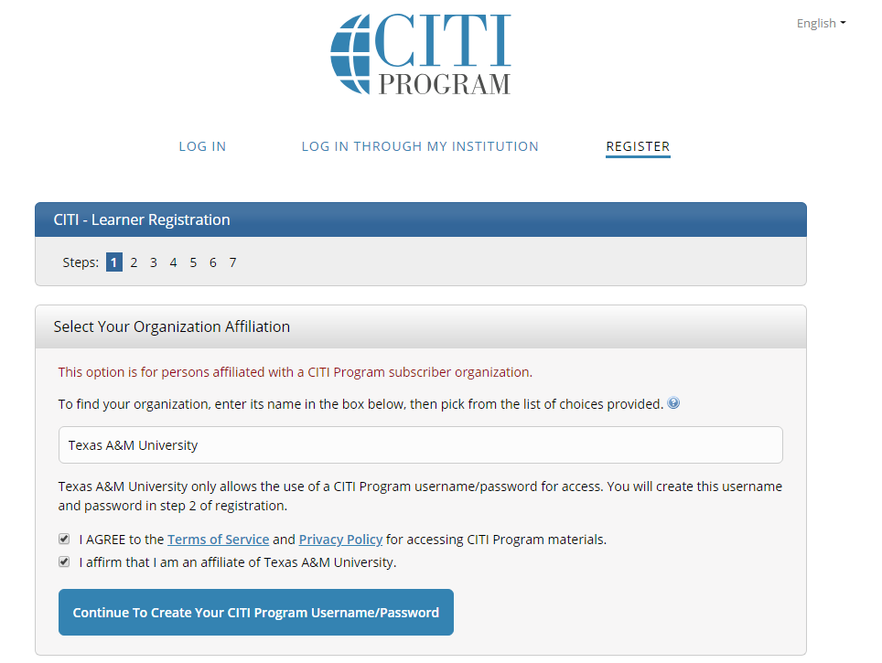
New User Registration – Organization Affiliation
Organization Affiliation:
Texas A&M University must be selected as the institution in order to access the correct IACUC training course (this includes visitors as well)
NOTE: Failure to select “Texas A&M University” as the organization could result in you taking the wrong course and may even result in a fee if you register a new Institution. External participants should also select Texas A&M University as the organization.
Check the box to agree to the Terms of Service and affirm you are an affiliate of Texas A&M University, and Click the button marked “Continue to Create Your CITI Program Username/Password”

Slide 4
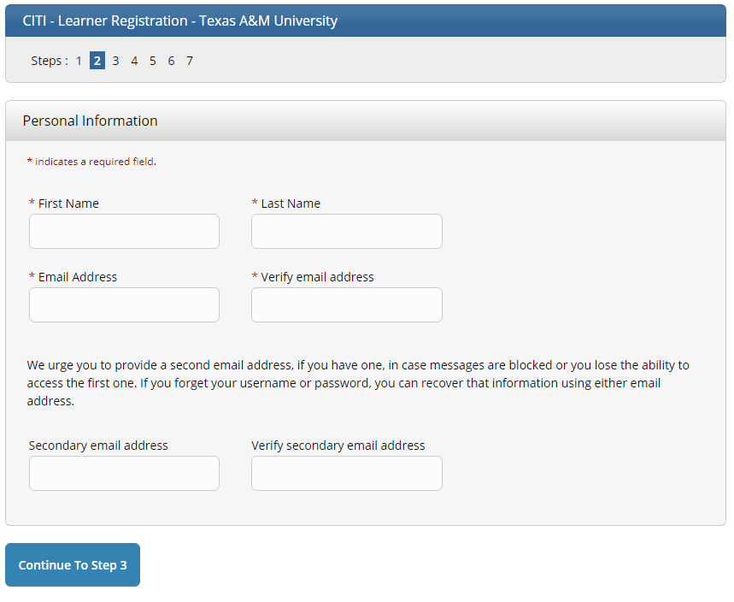
New User Registration – Personal Information
Complete the required fields
Click the button “Continue to Step 3”
NOTE: A secondary e-mail address is highly recommended as it can often times be helpful in determining a questionable user identity.

Slide 5
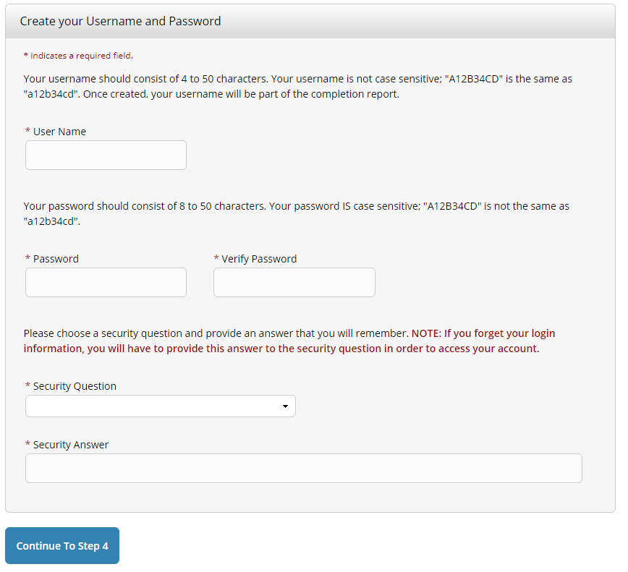
New User Registration – Username & Password
Create a Username and Password
and
select a security question and type a security answer.
Click on “Continue to Step 4”

Slide 6
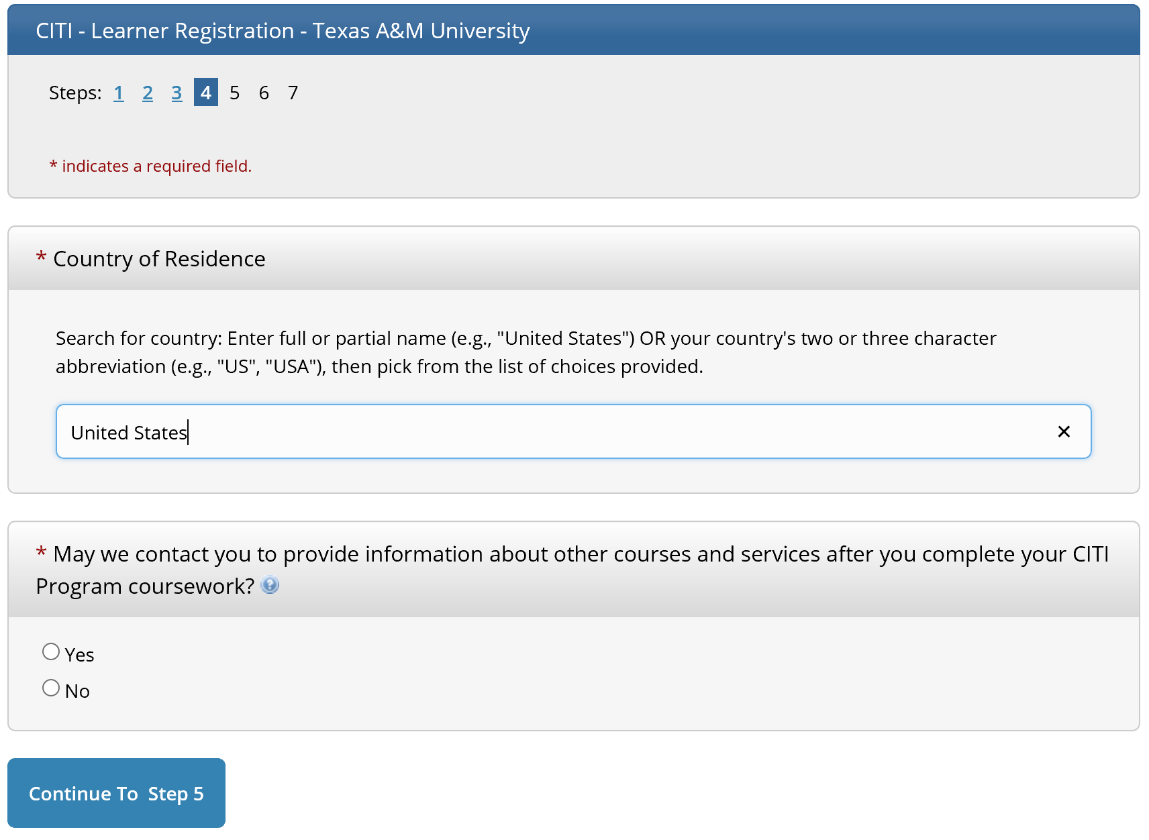
New User Registration – Country of Residence
Enter your country of residence
Select an option regarding participation in CITI Program research surveys.
Click “Continue To Step 5”

Slide 7
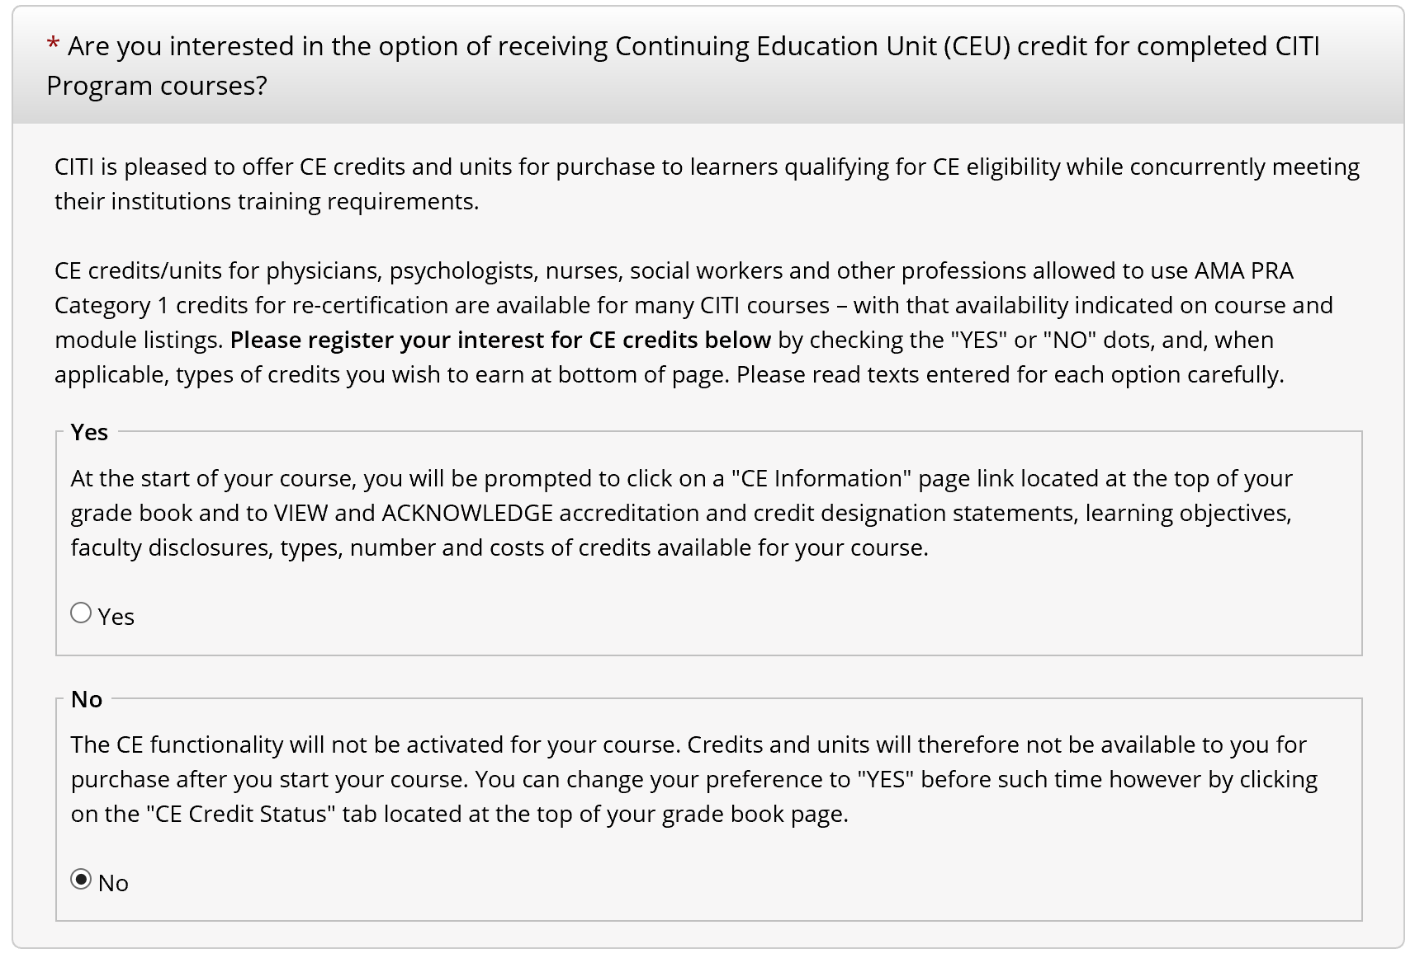
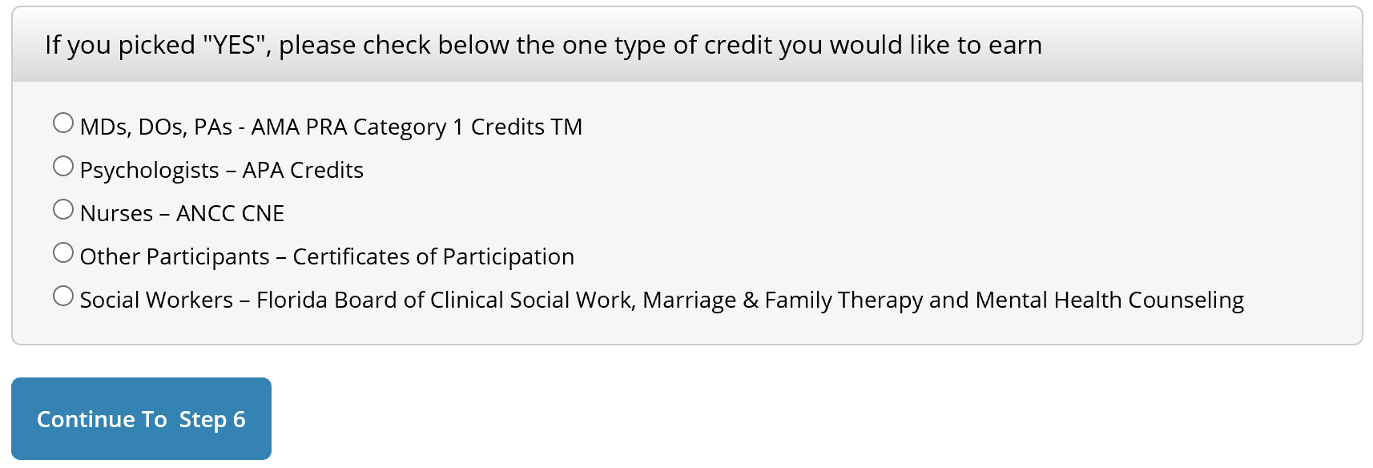
New User Registration – TAMU Continuing Education
Select “No” for the question relating to CE credits/units.
Note: The IACUC does not require CE units/credits. Therefore, if you select “Yes” you will be responsible for CEU purchases.
Click on “Continue to Step 6”

Slide 8
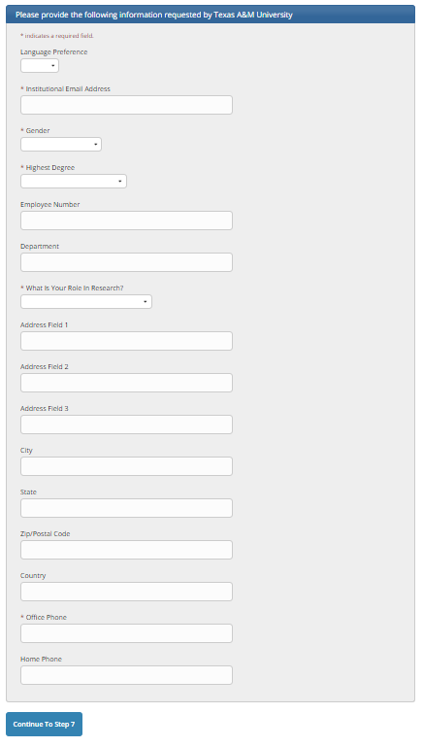
New User Registration – Required Information
At a minimum, please complete the required fields.
Click “Continue to Step 7”

Slide 9
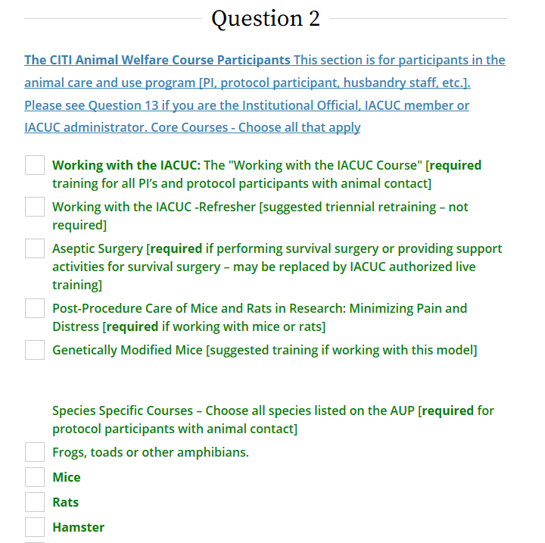
Selecting Curriculum – TAMU Question 2 (CITI Lab Animal Welfare Course)
Select the box “Working with the IACUC”.
Select other activity dependent and species-specific courses, as applicable. See TAMU-G-029 Guidelines for Animal Protocol Participation and Handling

Slide 10
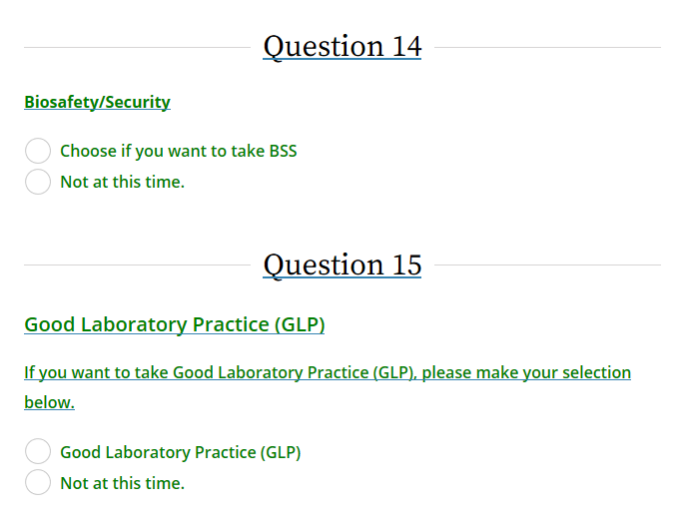
Selecting Curriculum – TAMU (cont.)
You can ignure the “Not at this time” option for Questions 5-13
Click
“Complete Registration”

Slide 11
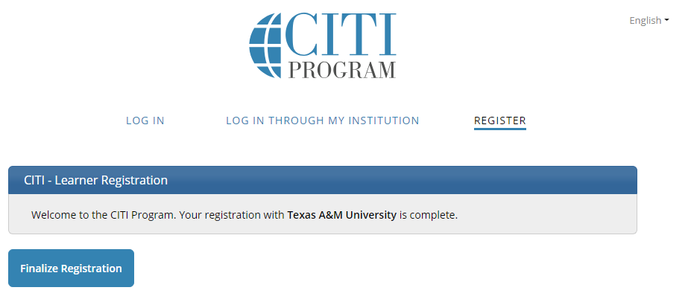
Finalize Registration
Click “Finalize Registration”

Slide 12
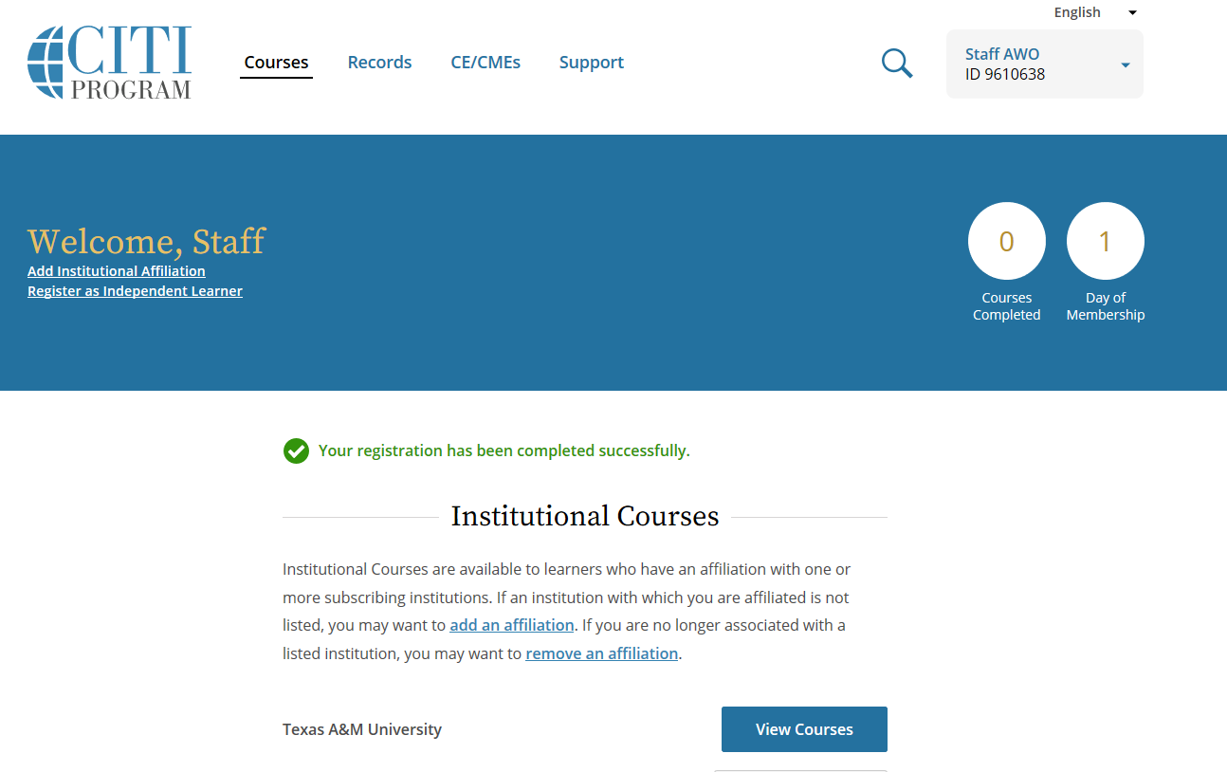
Texas A&M Courses
Click “View Courses” next to Texas A&M University.

Slide 13
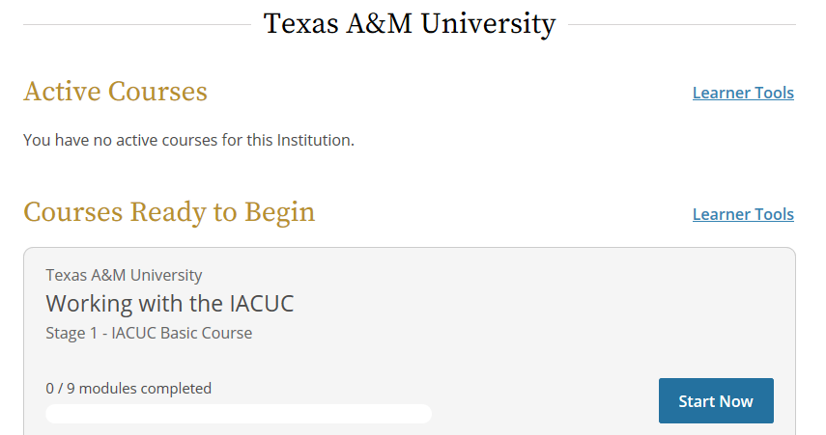
Completing a Course
The instructions provided on the next several slides will apply to all courses selected.
Click “Start Now” to start the Working with the IACUC Course

Slide 14
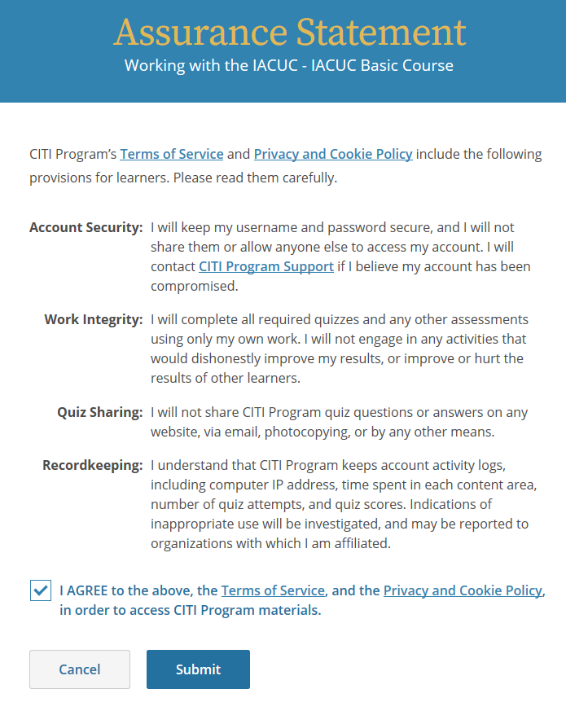
Individual Course Assurance Statement
Complete the Assurance Statement by checking the box and selecting “Submit”

Slide 15
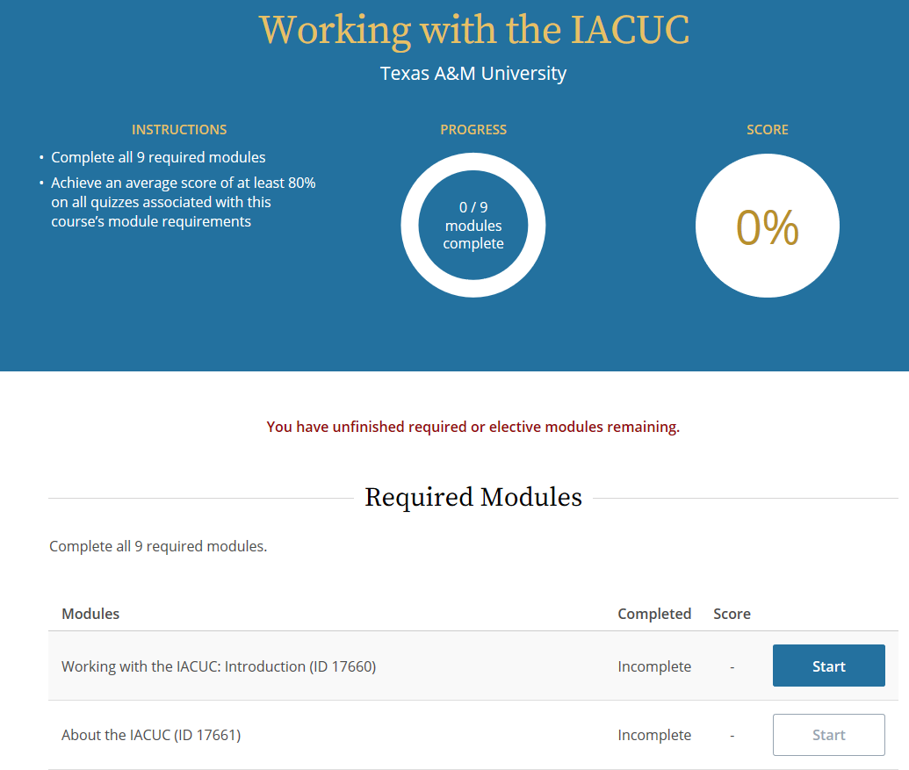
Required Modules
Each course will indicate the number of required modules you must pass to complete the course, as well as the passing score.
Supplemental modules (listed at bottom of screen) may be completed if desired, but are not required to gain course credit.
Click the blue Start button to start the module.

Slide 16
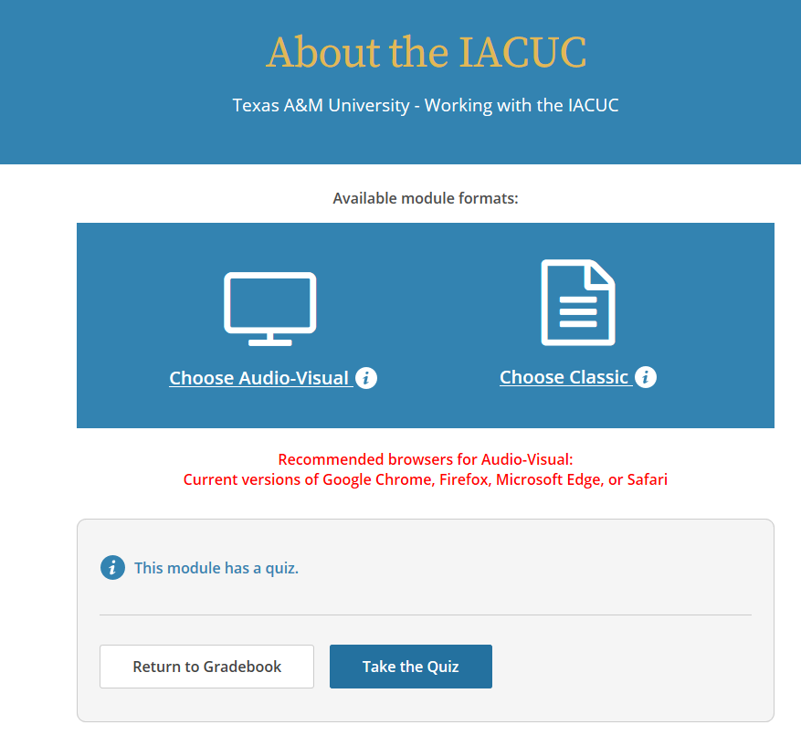
Chose Type of Presentation
Courses may be offered in more than one format.
Chose the format that works best for your learning style.
Select the “Take the Quiz” button after viewing the module.
You will be given an opportunity to retake the quiz if you do not receive a passing score.

Slide 17
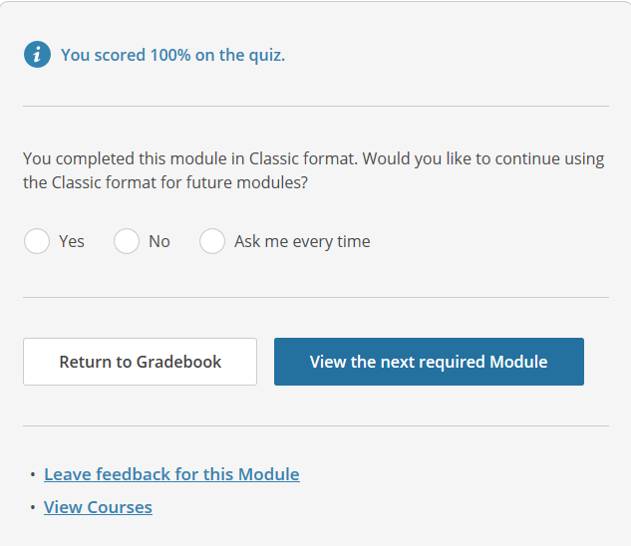
Moving to the Next Module
Once you complete the first quiz you will have the option to select the same format for all remaining modules or make a selection each time.
Select “Return to Gradebook” if you wish to see your overall status.
Select “View the next required Module” to continue the course.

Slide 18
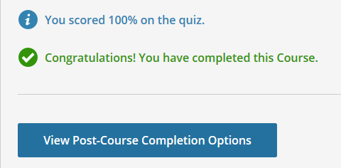
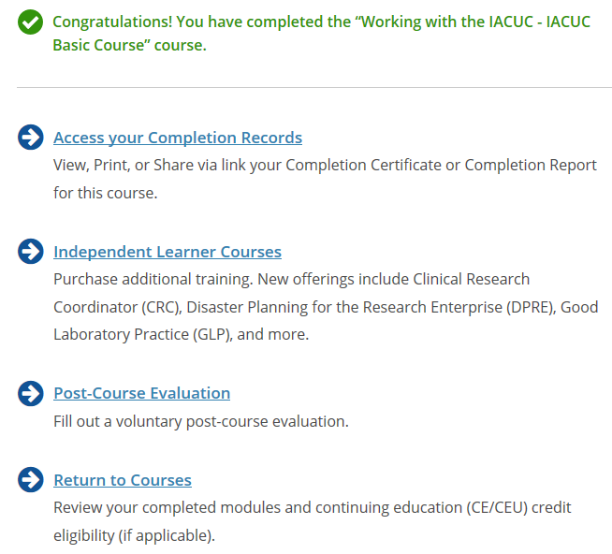
Course Completion
The “View Post-Course Completion Options” button will be visible once you complete the final quiz.
You may either click the button to view these options OR scroll up to select “Courses” from the top of the page to return to the Institutional Courses landing page.

Slide 19
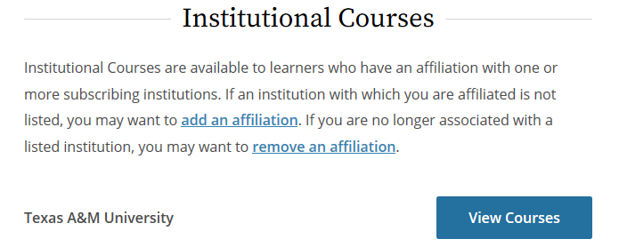
Course Completion, Cont.
Click the “View Courses” button to see the course you just completed listed under the “Completed Courses” section of the Courses page.

Slide 20
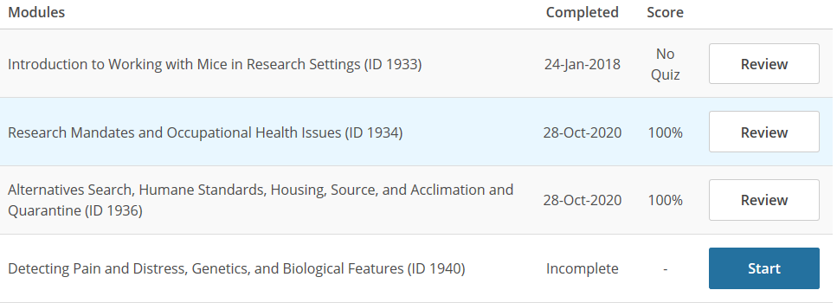
Continuing a Course
You may also choose to complete a few modules – returning later to complete the course.
Find the incomplete course in the Active Courses section on the Course page and click the “Continue Course” button.
Click the “Start” button to complete the next module in the course.

Slide 21
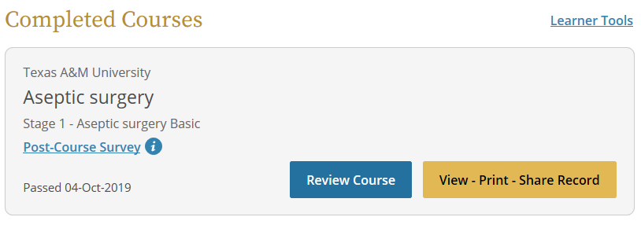
Done!
Repeat the process until all IACUC required courses are listed in the “Completed Courses” section of the CITI Courses page.
You are now done!

